Slide 1

TREES

Slide 2
Trees in General
A tree has a set of nodes and directed edges that connect them
One node is distinguished as the root
Every node (except the root) is connected by exactly one edge from exactly one other node
A unique path traverses from the root to each node
Root

Slide 3
Some tree terminology
Node An element in the tree references to data and other nodes
Path The nodes visited as you travel from root down
Root The node at the top It is upside down!
Parent The node directly above another node (except root)
Child The node(s) below a given node
Leaves Nodes with no children
Height The length of a path (number of edges, -1 for empty trees)
Levels The top level is 0, increases
Degree The maximum number of children from one node

Slide 4
Some tree terminology
Left Descendent A node n2 is a left descendent of node n1 if n2 is either left son of n1 or a descendent of the left son of n1.
Brothers Two nodes are brothers if they are left and right sons of the same father.
Depth Maximum level of any leaf in the tree.

Slide 5
An example of binary tree (1)
root: A
node: A, B, C, …, H, I
father of B: A
sons of B: D, E left son of B: D right son of B: E
depth: 3
ancestors of E: A, B
descendants of B: D, E, G
level
0
A
1
B
C
2
D
E
F
3
G
H
I

Slide 6
An example of binary tree (2)
left descendant of B: D
right descendant of B: E, G
brother: B and C are brothers
D and E are brothers
leaf: a node that has no sons e.g. D, G, H, I
left subtree of A:
right subtree of A:
B
C
D
E
F
G
H
I

Slide 7
Definitions
root
Node 0 is ancestor
of all other nodes
Nodes 1-6 are
descendants
of node 0
Node 0
Node 1,2,3 are children of root
Node 1
Node 2
Node 3
Node 1 is parent of
Nodes 4,5
Node 4
Node 5
Node 6
leaves
Node 4 and 5 are siblings

Slide 8
Binary Trees
A binary tree is a tree where all nodes have zero, one or two children
Each node is a leaf (no children), has a right child, has a left child, or has both a left and right child
A
B
C
D
F
D

Slide 9
The Binary Tree
Structure has nodes to store an element along with the left and right children (binary trees)
root is like first, front, or top in a singly linked structure
nodes
root
"T"
"L"
"R"
edges

Slide 10
Strictly Binary Trees
If every non leaf node in a binary tree has nonleaf left and right subtree the tree is called strictly binary tree.
A strictly binary tree with n leaves always contains 2n-1 nodes.

Slide 11
Complete Binary Trees
A complete binary tree of depth d is strictly binary tree all of whose laves are at level d.
depth 1
depth 2
depth 3
complete
incomplete
incomplete

Slide 12
Complete binary tree of depth 3
# of nodes in a complete binary tree of depth d:
A
B
C
D
E
F
G
H
I
J
K
L
M
N
O

Slide 13
Complete Binary Trees
Properties:
A complete tree with depth n has at most 2^{n+1} – 1 elements
At level l complete tree contains at most least 2^{l} elements
The index of the left child of node k is 2k+1, the index of the right child of node is 2k+2
depth 0
depth 1
depth 2
0
1
2
3
4
5
6

Slide 14
Other Kinds of Binary Trees (Almost Complete Binary trees)
A binary tree of depth d is Almost Complete Binary Tree if
Any node at level less than d-1 has two sons.
For any node nd in the tree with right descendent at level d, nd must have a left son and every left descendent of nd is either a leaf at level d or has two sons.

Slide 15
Almost Complete Binary Tree
(b)
(a)
(c)
(d)

Slide 16
Operations on Binary Trees
Let p be a pointer to a node nd of a binary tree then
info(p) returns contents of nd.
left(p) returns pointer to the left son of nd.
right(p) returns pointer to the right son of nd.
Father(p) returns pointer to father of nd.
brother(p) returns pointer to brother of nd.
Isleft(p) returns value true if nd is left son
isright(p) returns value true if nd is right son

Slide 17
Algorithm for isleft
q = father(p);
If (q==null)
return false;
If (left(q)==p)
return true;
return false;

Slide 18
Applications of Binary Trees
A tree can be used to find out all the duplicates in the list. No of comparisons can be reduced using binary tree.
First number is selected as root.
Each successive number is then compared with root
If it matches it is duplicate.
If number is smaller then search left sub tree.
If number is larger then search right sub tree.

Slide 19
Applications of Binary Trees
Input : 14,15,4,9,7,18,3,5,16,4,20,17,9,14,5
14
4
15
3
9
18
7
16
20
5
17

Slide 20
Algorithm
Get (no);
root = maketree(no);
while (there are numbers left in the input){
Get(no);
p=q=root;
while(no!=info(p) && q!=NULL){
p = q;
if (no<info(p))
q = left(p);
else
q = right(p);
} /* end while
if (no == info(p)) S.O.P(“Duplicate”);
else if (no <info(p))
setleft(p, no);
else setright(p, no);
} /* end while

Slide 21
Binary Search Trees
Key property
Value at node
Smaller values in left subtree
Larger values in right subtree
Example
X > Y
X < Z
X
Y
Z

Slide 22
Binary Search Trees
Examples
5
10
10
2
45
5
30
5
45
30
2
25
45
2
25
30
10
25
Binary search trees
Non-binary search tree

Slide 23
Tree Traversals
Used to print out the data in a tree in a certain order
Tracing the elements in a tree
Can’t go from first to last
Need to go up and down the levels
Recursion helps keep track with backtracking

Slide 24
PreOrder Traversal(root,left,right)
Print the data at the root
Traverse the left subtree in preorder
Traverse the right subtree in preorder
Traverse the following tree
A
B
G
D
C
E
F

Slide 25
InOrder Traversal(left,root,right)
Traverse the left subtree in inorder
Print the data at the root
Traverse the right subtree in inorder
Traverse the following tree
A
B
G
D
C
E
F

Slide 26
PostOrder Traversal(left,right,root)
Traverse the left subtree in postorder
Traverse the right subtree in postorder
Print the data at the root
Traverse the following tree
A
B
G
D
C
E
F

Slide 27
Representing a forest by a binary tree
corresponding binary tree
A
preorder traversal:
A B C D E F G H I J M K L
inorder traversal:
B D E F C A H G M J K L I
postorder traversal:
F E D C B H M L K J I G A
B
G
C
H
I
D
J
E
M
K
F
L

Slide 28
Application: Expression Trees
Binary trees can represent arithmetic expressions
An infix expression will have a parent operator and two children operands:
-
The expression:
((3+(7*2))-1)
Each parenthesized expression
becomes a tree. Each operand
is a leaf, each operator is
an internal node
+
1
3
*
7
2

Slide 29
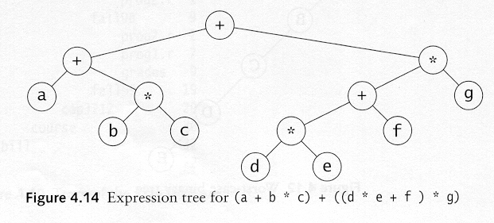
Preorder, Postorder and Inorder
Preorder traversal
node, left, right
prefix expression
++a*bc*+*defg

Slide 30
Preorder, Postorder and Inorder
Postorder traversal
left, right, node
postfix expression
abc*+de*f+g*+
Inorder traversal
left, node, right.
infix expression
a+b*c+d*e+f*g

Slide 31
Binary search tree
14, 15, 4, 9, 7, 18, 3, 5, 16, 4, 20, 17, 9, 14, 5
14
4
15
3
9
14
18
7
9
16
20
5
17
inorder traversal
sorted: 3,4,4,5,5,7,9,9,14,14,15,16,17,18,20
4
5

Slide 32
Assignment
Write down recursive algorithm to determine
Number of nodes in the tree
Sum of contents of all the nodes in binary tree
Find out a number in the binary tree

Slide 33
Dynamic Implementation
Let us implement binary trees using lists.
class Node
{
int data;
Node left, right; // null if empty
}
class bst()
{ public node root;
public bst()
{root = NULL;}
}
Left and right are the pointers to left and right child of a node.

Slide 34
Creation of a new tree
maketree(x): Create a new tree consisting of a single node
Node maketree(int x)
{
Node newer = new Node();
newer.info = x;
newer.left = null;
newer.right = null;
return newer ;
} /* end maketree */
X

Slide 35
Creation of a new son
setleft(p, x): create a new left son of node p
with information field x.
void setleft(Node p, int x)
{
if (p == null)
S.O.P("void insertion”);
else if (p.left != null)
S.O.P(invalid insertion)”;
else
p.left = maketree(x);
} /* end setleft */
p
p
x

Slide 36
Internal & External Nodes
Sometimes for leaf and nonleaf nodes different data structures are used as leaf nodes do not contain left and right pointers.
When this distinction is made nonleaf nodes are called internal nodes.
Leaf nodes are called external nodes.

Slide 37
Traversals in Java
Routine for preorder traversal
void pretrav(Node tree)
{
if (tree != null)
{
S.O.P(tree.info);
pretrave(tree.left);
pretrave(tree.right);
}
}

Slide 38
Traversals in Java
Routine for inorder traversal
void intrav(Node tree)
{
if (tree != NULL)
{
intrave(tree.left);
S.O.P(tree.info);
intrave(tree.right);
}
}

Slide 39
Traversals in Java
Routine for postorder traversal
void postrav(Node tree)
{
if (tree != NULL)
{
postrave(tree.left);
postrave(tree.right);
S.O.P(tree.info);
}
}

Slide 40
Traversals in Java
Now let us consider traversal using non recursive routine for inorder traversal. We need a stack for this purpose.
class stack
{
int top;
Node item[100];
};

Slide 41
Traversals in Java
void intrav2(Node root)
{ stack s = new stack(50);
Node p;
p = root;
do{
while (p!= null){
s.push(p);
p = p.left;
}/* end while
if (!s.empty()){
p = s.pop();
S.O.P(p.info);
p= p.right;
}/* end if
}while (!s.empty() || p!= null);
}

Slide 42
Comparison of traversals
Recursive solution is more efficient as
There is no extra recursion.
Stack can not be eliminated in non recursive solution.
There are no extra parameters and local variables in recursive function.

Slide 43
Right in-threaded binary tree
A node with an empty right subtree points to its inorder successor. It can be traversed in inorder without a stack.
setleft(p, x):
A
B
C
**
E
F
D
setright(p, x):
**
G
H
I

Slide 44
Implementation of a right in-threaded binary tree
Dynamic implementation:
class Node{
int info;
Node left; // reference to left son
Node right; // reference to right son
boolean rthread; // rthread is TRUE if // right is NULL or
} // a non-NULL thread

Slide 45
Creation of a new tree
maketree(x): Create a new tree consisting of a single node
Node maketree(int x)
{
Node newer= new Node;
newer.info = x;
newer.left = null;
newer.right = null;
newer.rthread = true;
return p;
} /* end maketree */
X

Slide 46
Creation of a new left son
void setleft(Node p, int x)
{
Node newer;
if (p == null)
S.O.P("void insertion”);
else if (p.left != null)
S.O.P("invalid insertion”);
else{
newer = new Node();
newer.info = x;
p.left = newer;
newer.left = NULL;
newer.right = p;
newer.rthread = true;
}
} /* end setleft */

Slide 47
Creation of a new right son
void setright(Node p, int x)
{
Node newer, r;
if (p == null)
S.O.P("void insertion”);
else if (!p.rthread)
S.O.P(“invalid insertion”);
else{
newer = new node;
newer.info = x;
r = p.right;
p.right = newer;
p.rthread = false;
newer.left = null;
newer.right = r;
newer.rthread = true;
}
} /* end setleft */

Slide 48
Implementation with JAVA
void intrav3()
{
Node p, q;
p = root;
do
{
q = null;
while (p != null)
{
q = p;
p = p.left;
}
if (q != null){
S.O.P(q.info);
p = q.right;
while(q.rthread && p!=null)
{
S.O.P(p.info);
q = p;
p = p.right;
} /* end while */
} /* end if */
}while (q != null)
} /* end intrav3 */

Slide 49
Heterogeneous binary trees
'+'
'+'
3
3
'/'
'*'
5
4
'-'
6
7
The binary tree represents 3 + 4*(6-7)/5 + 3.

Slide 50
The Huffman code (1)
Suppose we have a set of symbols: A, B, C, D
1) Each symbol is encoded by 3 bits (inefficient)
Message A B A C C D A would be encoded by 21 bits:
symbol code
A 0 1 0
B 1 0 0
C 0 0 0
D 1 1 1
010 100 010 000 000 111 010

Slide 51
The Huffman code (2)
2) Each symbol is encoded by 2 bits
Message A B A C C D A would be encoded by 14 bits:
symbol code
A 00
B 01
C 10
D 11
00 01 00 10 10 11 00

Slide 52
The Huffman code (3)
3) Huffman codes (variable-length codes)
symbol code
A 0
B 110
C 10
D 111
Message A B A C C D A would be encoded by 13 bits:
0 110 0 10 10 111 0
A frequently used symbol is encoded by a short bit string.

Slide 53
Huffman tree
ACBD,7
0
1
A,3
CBD,4
0
1
C,2
BD,2
0
1
B,1
D,1

Slide 54

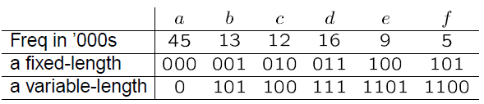

Huffman tree (Example-2)

Slide 55
Huffman tree (Example-2)
acdef 90
0
1
a 45
adfed55
0
1
cb 25
fed30
0
0
1
c 12
b 13
fe 14
d 16
0
1
f 5
e 9

Slide 56
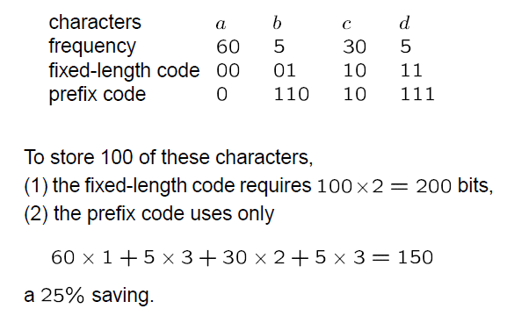
Huffman tree (Example-3)

Slide 57
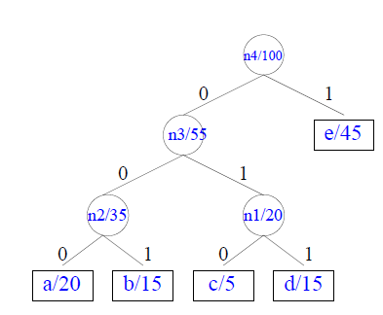
Huffman tree (Example-3)

Slide 58
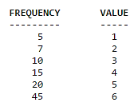


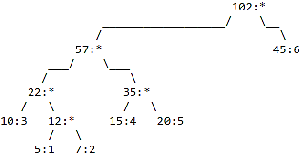
Huffman tree (Example-4)
Lets say you have a set of numbers and their frequency of use and want to create a huffman encoding for them:
(I)
(II)
(III)

Slide 59
Huffman tree (Example-5)
E I A D C G B F H
25 15 15 12 7 6 6 4 1
25 15 15 12 7 6 6 5
25 15 15 12 11 7 6
25 15 15 13 12 11
25 23 15 15 13
28 25 23 15
38 28 25
53 38
91
symbol
frequency

Slide 60
IHFBDEGCA,91
IHFBD, 38
EGCA, 53
I, 15
HFBD, 23
E, 25
GCA, 28
HFB, 11
D, 12
GC, 13
A, 15
HF, 5
B, 6
G, 6
C, 7
H, 1
F, 4
Sym Freq Code Sym Freq Code Sym Freq Code
A 15 111 D 12 011 G 6 1100
B 6 0101 E 25 10 H 1 01000
C 7 1101 F 4 01001 I 15 00

Slide 61
The result of Huffman coding
decode
A Huffman tree is a strictly binary tree. The Huffman algorithm is an optimal encoding scheme.
111 01000 10 111 011 A H E A D
encode

